Slide 1
The interhemispheric teleconnection across the critical line through a southerly duct during boreal winter and its dynamics
Sen Zhao
supervised by Prof. Jianping Li
Dr. Yanjie Li
2014-04-02

Slide 2
Contents
Introduction
Data and diagnostic tools
Observed interhemispheric teleconnection across the critical line
Theoretical basis for stationary Rossby wave propagation
Stationary wave propagation on DJF climatology flow
Conclusion and Discussions

Slide 3
Teleconnection
Definition
AMS glossary
J.M. Wallace’s UW courseware
Analysis Method
Correlations, empirical orthogonal function (EOF), rotated EOF, singular value decomposition, maximum covariance, and cluster analysis
A linkage between weather changes occurring in widely separated regions of the globe.
A significant positive or negative correlation in the fluctuations of a field at widely separated points.
Most commonly applied to variability on monthly and longer timescales, the name refers to the fact that such correlations suggest that information is propagating between the distant points through the atmosphere.
Occur in response to a wide variety of forcings
Have distinctive formation mechanisms
Structure depends upon the background flow

Slide 4
Teleconnection
Meridional teleconnection
North Atlantic oscillation (NAO) (Walker and Bliss, 1932)
North Pacific oscillation (NPO) (Rogers, 1981)
Pacific-North America (PNA) pattern (Wallace and Gutzler, 1981; Horel and Wallace, 1981)
Pacific-South America (PSA) pattern (Mo and Higgins, 1998)
Tropical-Northern Hemisphere (TNH) pattern (Mo and Livezey, 1986)
Pacific-Japan (PJ) / East Asia-Pacific (EAP) / India-Asia-Pacific (IAP) pattern (Nitta, 1987; Huang and Li, 1987; Li et al., 2013)
Zonal teleconnection
Winter: Eurasian (EU), circumglobal teleconnection (CGT) and the Southern Eurasian (SEA) (Wallace and Gutzler, 1981; Hsu and Lin, 1992; Hoskins and Ambrizzi, 1993; Branstator, 2002; Xu, 2013)
Summer: “silk road” and the CGT, Atlantic-Eurasian (AEA) (Ambrizzi et al., 1995; Joseph and Srinivasan, 1999; Lu et al., 2002; Enomoto et al., 2003; Ding and Wang, 2005; Wu et al., 2009b; Wu et al., 2012)
Linkages between NH and SH
Previous studies (Harnack and Harnack, 1985; Nicholson, 1986; Wu et al., 2007)
Interhemispheric teleconnection in boreal summer (Liu et al., 2010)
Influence of SAM on NH (Nan and Li, 2003; Nan et al., 2009; Song et al., 2009; Wu et al., 2009; Zheng et al., 2013)
Impact of the NH summer monsoons on SH subtropical anticyclones (Lee et al., 2013)
Effects of Atlantic warm pool on the southeastern Pacific (Wang et al., 2010)

Slide 5
A Rossby Wave Teleconnection Conundrum
The critical line (u=0) act as a barrier for stationary Rossby wave propagation between NH and SH according the canonical wave theory (Hoskins and Karoly, 1981)
Motivation
Is there an interhemispheric teleconnection pattern across the critical latitude associated with stationary Rossby wave propagation?
How do Rossby waves propagate across the critical line under the horizontal non-uniform flow?

Slide 6
Contents
Introduction
Data and diagnostic tools
Observed interhemispheric teleconnection across the critical line
Theoretical basis for stationary Rossby wave propagation
Stationary wave propagation on DJF climatology flow
Conclusions and Discussions

Slide 7
Data and diagnostic tools
Circulation
Convection
NCEP/NCAR | 1957.09—2010.12 | 2.5 × 2.5
ERA-40 | 1957.09—2002.08 | 2.5 × 2.5
ERA-Interim | 1979.01—2010.12 | 1.125 × 1.125
CMAP | 1979.01—2010.12 | 2.5 × 2.5
GPCP | 1979.01—2010.12 | 2.5 × 2.5
Interp_OLR | 1979.01—2010.12 | 2.5 × 2.5
Teleconnectivity (Wallace and Gutzler 1981)
Correlation and partial correlation analysis, student’s t test by the effective number of degrees of freedom (Li et al., 2012)
TN wave activity flux (Takaya and Nakamura, 2001)
Barotropic model
(Branstator, 1983)

Slide 8
Contents
Introduction
Data and diagnostic tools
Observed interhemispheric teleconnection across the critical line
Theoretical basis for stationary Rossby wave propagation
Stationary wave propagation on DJF climatology flow
Conclusion and Discussions

Slide 9
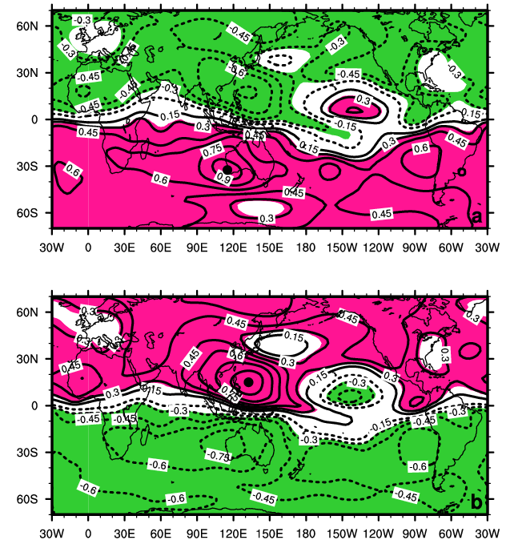
The zonally symmetric teleconnection
asymmetric components of streamfunction
(Hsu and Lin, 1992; Branstator, 1990)
Notes:
为了探讨热带地区的遥相关特征，对流场进行遥相关分析

Slide 10
Teleconnectivity of 250hPa eddy streamfunction
Figure 1

Slide 11
One-point correlation analysis
Figure 2

Slide 12
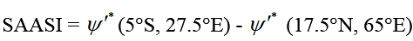
Definition of Southern Africa – Arabian Sea (SAAS) teleconnection index
Removing SEA, EU, PNA, WP teleconnections
Removing ENSO
Figure 3

Slide 13
Relationship with tropical convection
 | SAASI | CMAP | GPCP | OLR
SAASI |  | -0.65 | -0.64 | 0.61
CMAP |  |  | 0.95 | -0.94
GPCP |  |  |  | -0.93
Average region (17.5ºS-2.5ºS, 30ºE-110ºE)
Significant negative correlation between SAAS and convection over SH tropical India Ocean
Figure 4

Slide 14
Removing SEA, EU, PNA, WP and ENSO
 | SAASI | CMAP | GPCP | OLR
SAASI |  | -0.58 | -0.61 | 0.52
CMAP |  |  | 0.95 | -0.94
GPCP |  |  |  | -0.93

Slide 15
Circulation associated with SH tropical India Ocean convection
−
+
−
+
+
+
−
−
+
−
Figure 5

Slide 16
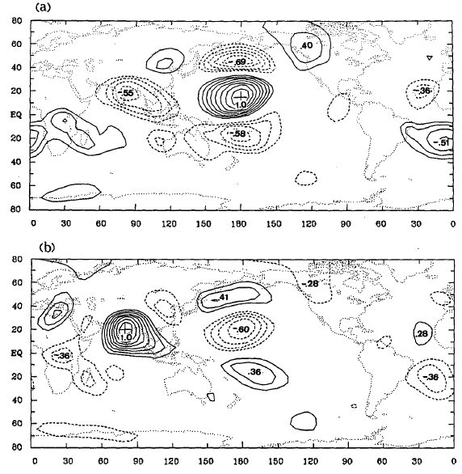
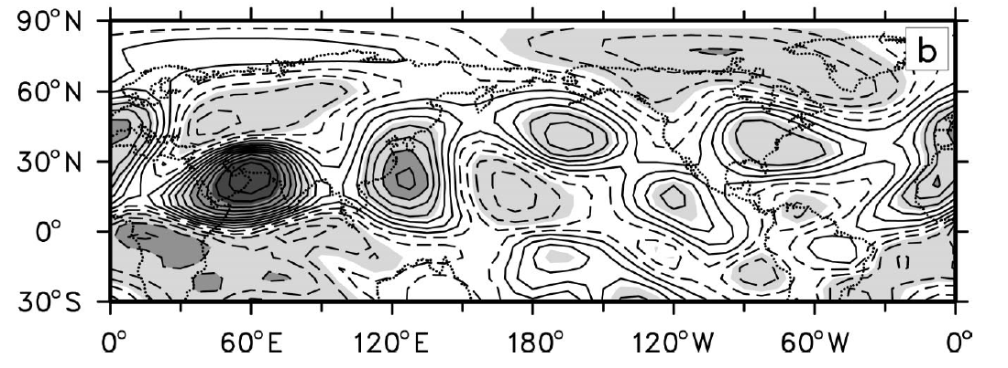
Indications from previous studies
low-pass filtered 250hPa eddy stream function correlation maps
one-point correlation plots of 300hPa stream function anomalies against (24.4°N, 60°E)
(Branstator, 1990) FIG. 12b
(Hsu and Lin, 1992) FIG. 4

Slide 17
Summary of observational analysis
An interhemispheric teleconnection was identified in 250hPa eddy stream function during boreal winter, which is across the critical line from Southern Africa to Arabian Sea (SAAS) with significant centers in all of South Asia and North Pacific in Northern Hemisphere, and South America and South Pacific in Southern Hemisphere.
The positive phase of SAAS is associated with suppressed convection over SH tropical India Ocean.
Questions: The dynamic mechanism of the interhemispheric low frequency teleconnection across the critical line?
Can stationary wave propagate across the critical line?
The propagation characteristics in the vicinity of the critical line?

Slide 18
Contents
Introduction
Data and diagnostic tools
Observed interhemispheric teleconnection across the critical line
Theoretical basis for stationary Rossby wave propagation
Stationary wave propagation on DJF climatology flow
Conclusion and Discussions

Slide 19
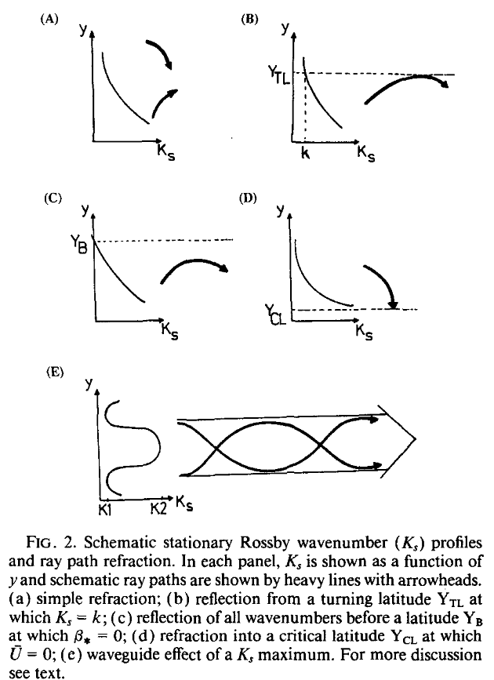
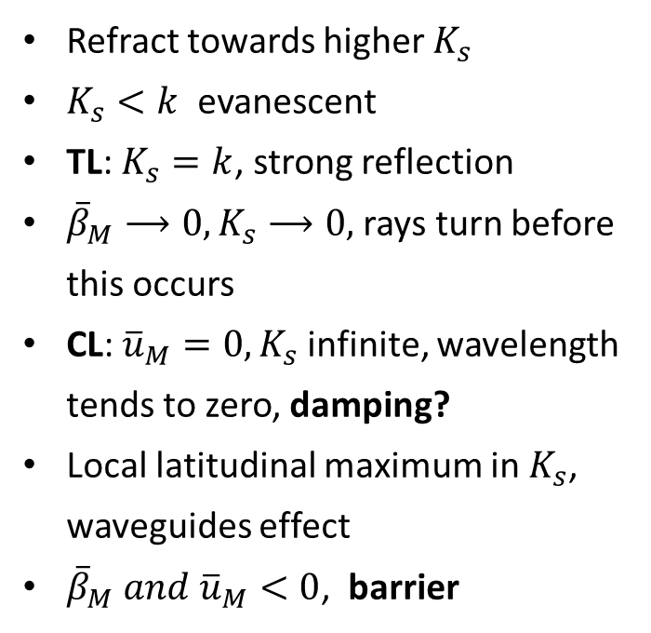
Rossby wave on zonal symmetric flow
Refract towards higher $K_{s}$
$K_{s}<k$ evanescent
TL: $K_{s}=k$, strong reflection
${\overline{β}}_{M}⟶0, K_{s}⟶0,$ rays turn before this occurs
CL: ${\overline{u}}_{M}=0, K_{s}$ infinite, wavelength tends to zero, damping?
Local latitudinal maximum in $K_{s}$, waveguides effect
${{\overline{β}}_{M} and \overline{u}}_{M}<0$, barrier
(Hoskins and Karoly, 1981; Hoskins and Ambrizzi, 1993)

Slide 20
Stationary wavenumber K_{s} at 250hPa (DJF)
Polar-front jet waveguide
North America jet waveguide
North Africa-Asia jet waveguide
Evanescent region
Westerly duct waveguide
SH jet waveguide
1958-2002 DJF climatology

Slide 21
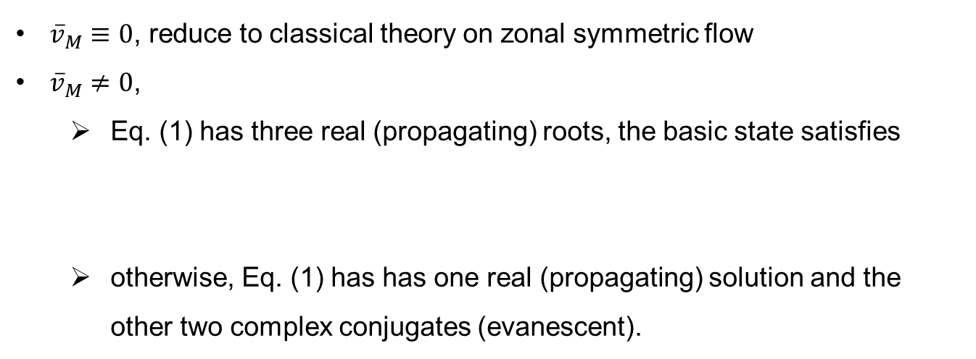
Rossby wave on horizontal non-uniform flow
The dispersion relation
(Opsteegh, 1982; Schneider and Watterson, 1984; Li and Li, 2012)
${\overline{v}}_{M}≡0$, reduce to classical theory on zonal symmetric flow
${\overline{v}}_{M}≠0$,
Eq. (1) has three real (propagating) roots, the basic state satisfies
otherwise, Eq. (1) has has one real (propagating) solution and the other two complex conjugates (evanescent).
Group velocity

Slide 22
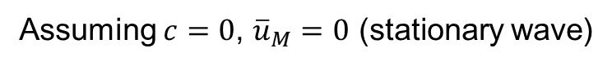
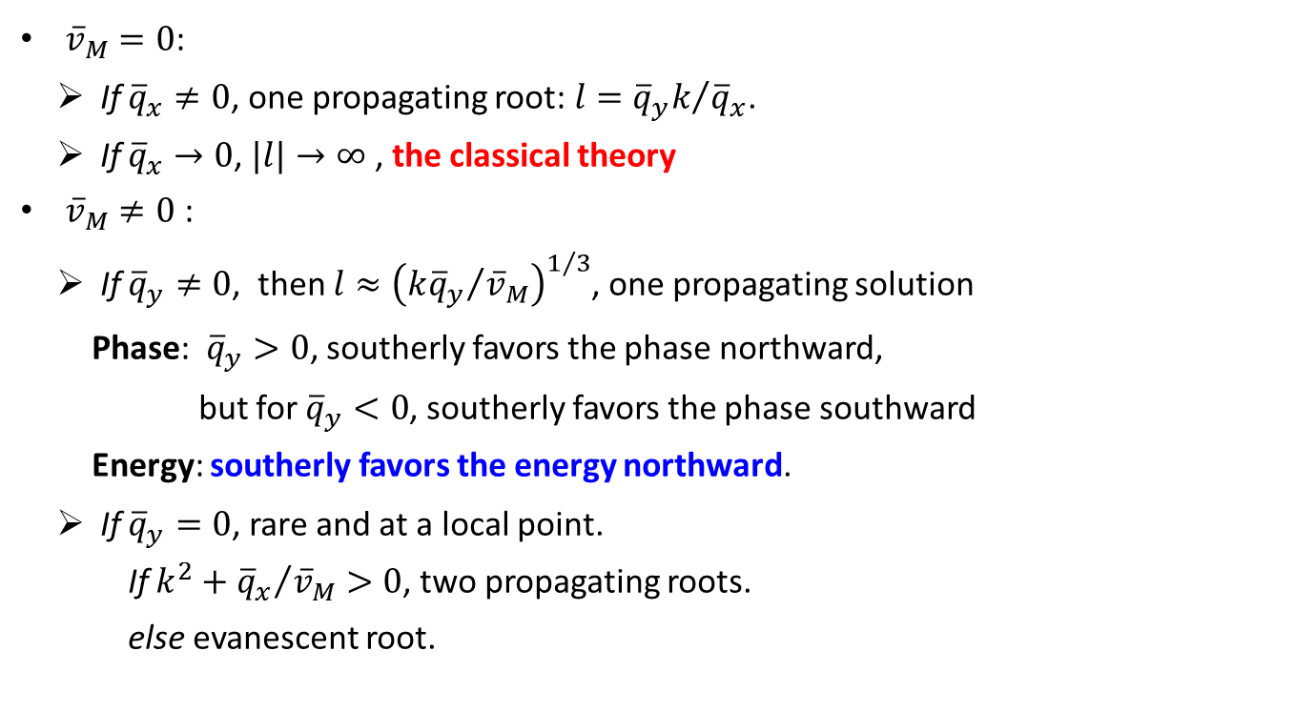
Propagation behaviors at a critical line
Assuming $c=0$, ${\overline{u}}_{M}=0$ (stationary wave)
The dispersion relation reduces
${\overline{v}}_{M}=0$:
If ${\overline{q}}_{x}≠0$, one propagating root: $l={{\overline{q}}_{y}k}/{{\overline{q}}_{x}}$.
If ${\overline{q}}_{x}→0$, $|l|→∞$ , the classical theory
${\overline{v}}_{M}≠0$ :
If ${\overline{q}}_{y}≠0$, then $l≈{\left({k{\overline{q}}_{y}}/{{\overline{v}}_{M}}\right)}^{1/3}$, one propagating solution
Phase: ${\overline{q}}_{y}>0$, southerly favors the phase northward,
but for ${\overline{q}}_{y}<0$, southerly favors the phase southward
Energy: southerly favors the energy northward.
If ${\overline{q}}_{y}=0$, rare and at a local point.
If $k^{2}+{{\overline{q}}_{x}}/{{\overline{v}}_{M}}>0$, two propagating roots.
else evanescent root.

Slide 23
Contents
Introduction
Data and diagnostic tools
Observed interhemispheric teleconnection across the critical line
Theoretical basis for stationary Rossby wave propagation
Stationary wave propagation on DJF climatology flow
Conclusion and Discussions

Slide 24
Basic flow at 250hPa
southerly duct
In most areas
Figure 6

Slide 25
Basic state notes
Zonal varying zonal flow (ZVZF)
Partial horizontal non-uniform flow (PHNF)
Full horizontal non-uniform flow (FHNF)

Slide 26
Propagating root numbers distribution
For k = 4 (about 7000km at 45º)
In ZVZF
Two propagating roots or evanescent
In PHZF
three roots in NH jet, SH midlatitude or near v = 0.
In tropical region and NH high latitudes, waves favor one propagating solution.

Slide 27
Three roots in PHNF v.s. two roots in ZVZF
For k = 4, 50ºS – 30ºS region:
Two of three roots in PHNF are very close to that in ZVZF
The other one root is very large (>20), i.e., small wavelength (<1000km)
MWN in ZVZF
MWN in PHNF

Slide 28
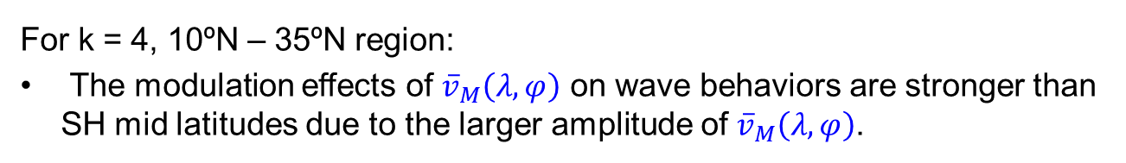
The three propagating roots behaviors
For k = 4, 10ºN – 35ºN region:
The modulation effects of ${\overline{v}}_{M}\left(λ,φ\right)$ on wave behaviors are stronger than SH mid latitudes due to the larger amplitude of ${\overline{v}}_{M}\left(λ,φ\right)$.

Slide 29
Differences between PHNF and FHNF are very small, especially for small scale waves
k = 1
k = 4

Slide 30
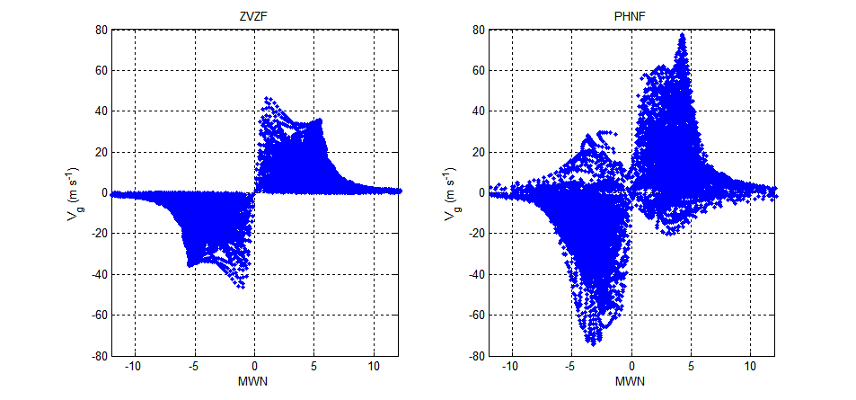
Phase direction and wavepacket direction
ZVZF
PHNF

Slide 31
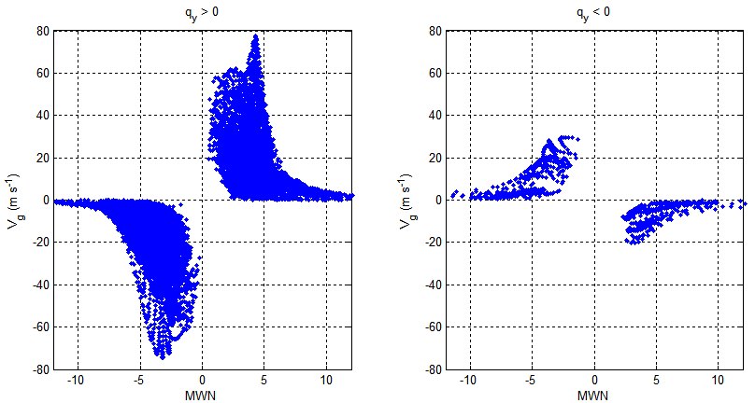
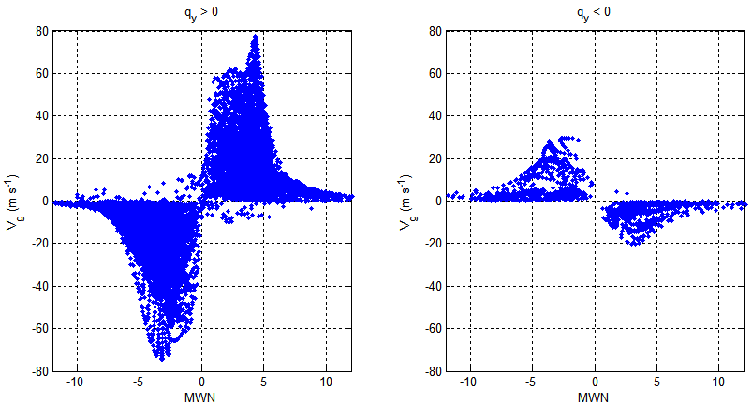
The modulation of q_{y} on relationship between phase and wavepacket direction
q_{y} > 0
q_{y} < 0
> 1.0×10⁻¹² m⁻¹ s⁻¹
< -1.0×10⁻¹² m⁻¹ s⁻¹

Slide 32
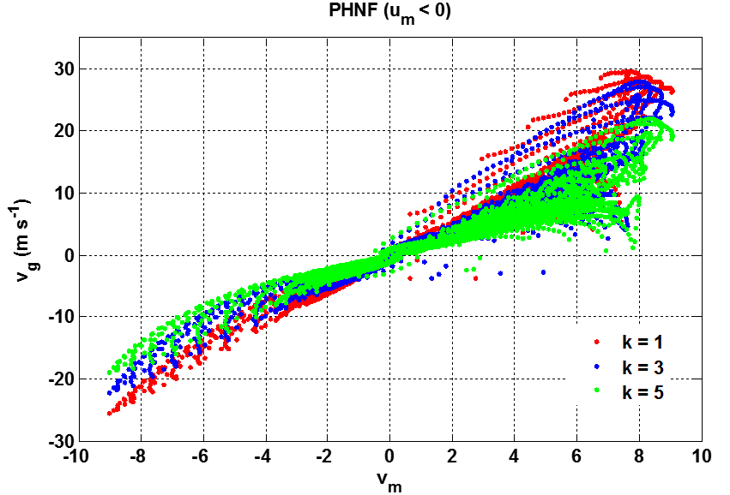
Wavepacket direction v.s. basic flow
In the easterly
northerly(southerly) favors southward (northward) wavepacket propagation
Waves with bigger zonal scales have larger meridional group velocity

Slide 33
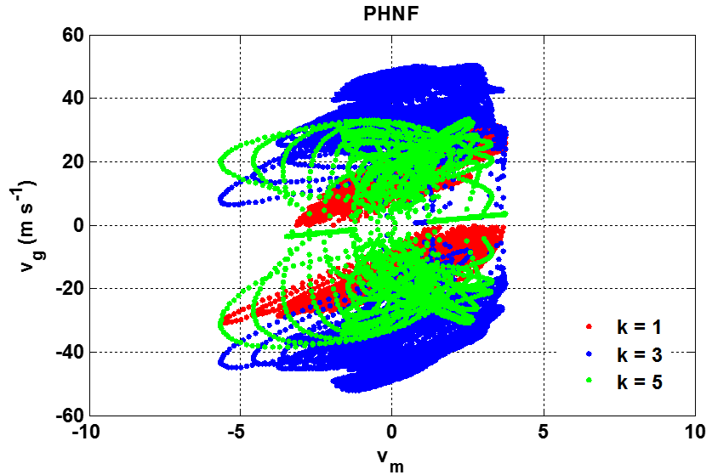
No simple relationship in the westerly
50ºS – 30ºS region:

Slide 34
Stationary meridional wavenumber and group velocity
ZVZF( k = 1 )
PHNF( k = 1 )
Notes:
左边一列为

Slide 35
ZVZF( k = 3 )
PHNF( k = 3 )

Slide 36
Wave ray tracing technique
Shaded: correlation of esf on SAASI

Slide 37
Response of barotropic model to tropical forcing

Slide 38
Contents
Introduction
Data and diagnostic tools
Observed interhemispheric teleconnection across the critical line
Theoretical basis for stationary Rossby wave propagation
Stationary wave propagation on DJF climatology flow
Conclusion and Discussions

Slide 39
Conclusion
An interhemispheric teleconnection was identified in 250hPa eddy stream function during boreal winter, which is across the critical line from Southern Africa to Arabian Sea (SAAS) with significant centers in all of South Asia and North Pacific in NH, and South America and South Pacific in SH. The positive phase of SAAS is associated with suppressed convection over SH tropical India Ocean.
Theoretical analysis proved that meridional ambient flow opens up a way for one-way propagations of stationary wave cross the easterly. Wavepacket meridional propagating direction in the easterlies is always the same with meridional basic flow, while that of wave phase is regulated by the sign of meridional gradient of absolute vorticity.
Wave ray technique and barotropic model results confirmed the SAAS teleconnection is associated with stationary Rossby wave-packets propagation across the critical line.

Slide 40
Discussions
SAAS teleconnection three dimensional structure and influence on NH and SH climate.
Vertical propagation across the critical line and troposphere–stratosphere interactions.
Nathan and Hodyss (2010) have derived an extended Charney-Drazin condition for zonally non-uniform background flow, and showed that local vertical propagation (trapping) is possible for wave scales for which the traditional Charney-Drazin condition predicts trapping (propagation). However, the vertical propagation behaviors of waves in more realistic flow are unclear.
Application of Rossby wave theory on horizontal non-uniform flow in mid and high latitude.

Slide 41
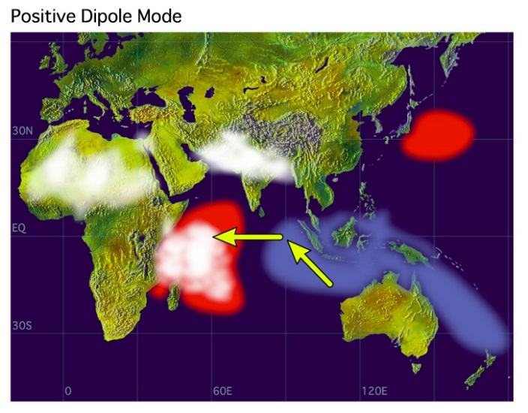
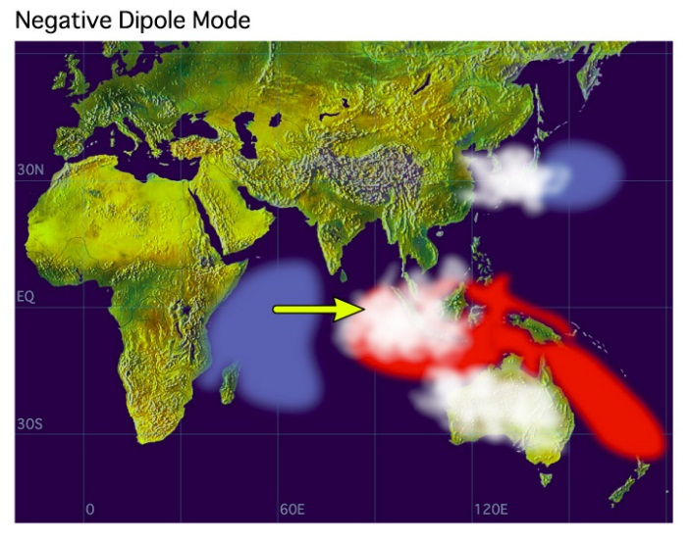
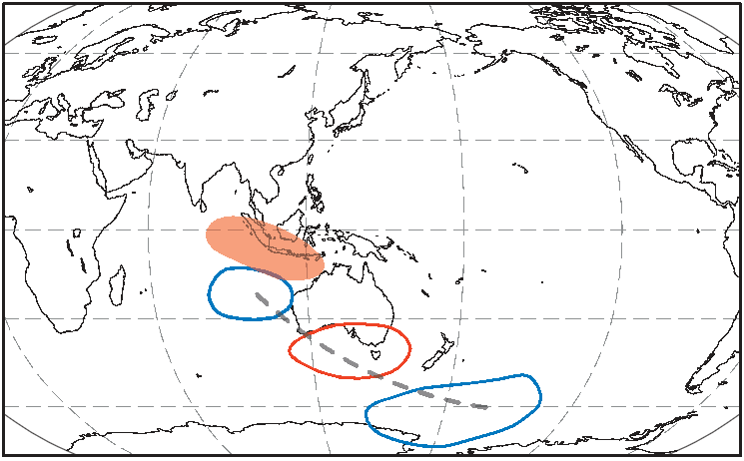
IOD teleconnection (JJA)
(Saji et al., 1999)
a barrier to Rossby wave propagation
on the southern flank of the sub-tropical jet over Australia
(Cai et al., 2011)
Notes:
印度洋偶极子是印度洋的海气耦合现象，反应了东南赤道印度洋和西赤道印度洋的SST的跷跷板式振荡。Cai等研究IOD通过Rossby波列影响澳洲冬季（JJA）降水。但是从定常波数分布上看出，澳洲南侧急流的负绝对涡度经向梯度阻碍了波的南传。因此传统理论在解释中高纬度地区的波传播也存在缺陷。

Slide 42
谢谢！
恳请您留下的宝贵意见建议！

Slide 43
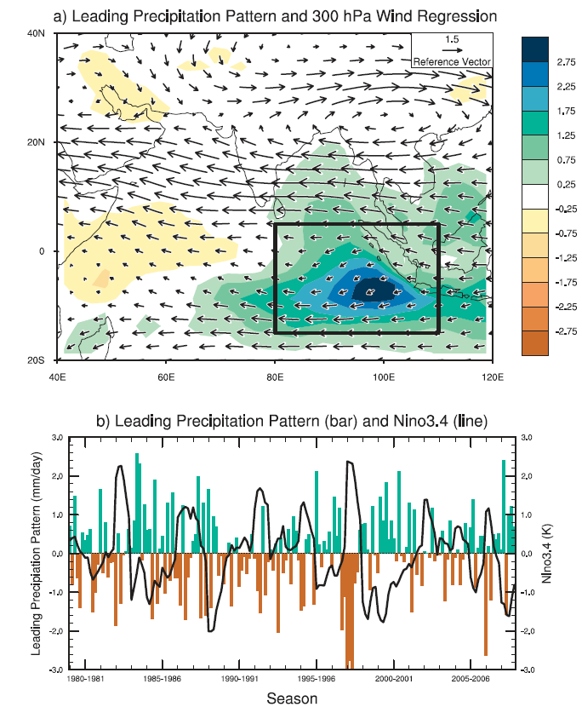
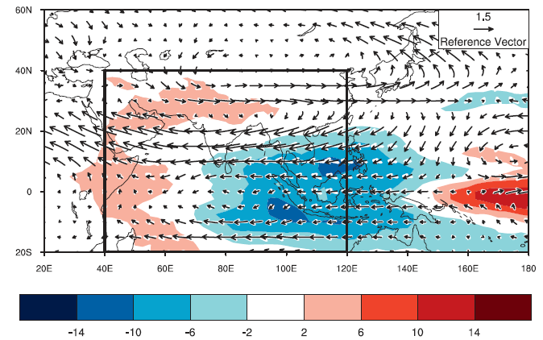
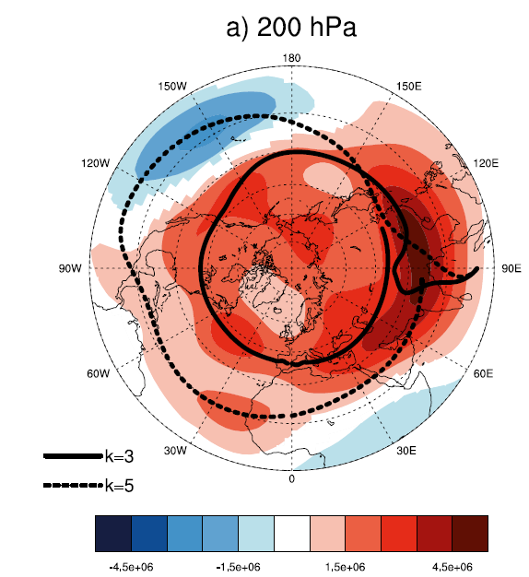
India Ocean Convection and NH climate
20ºS-40ºN,40ºE-120ºE, Nov-Apr
OLR
cor vs Niño-3.4
Monthly : -0.4
Seasonally averaged: -0.7
(Hoell et al., 2012, 2013)

Slide 44
For 1979-2010

